Slide 1
Productivity & AI Transformation
August 27, 2024
Discussion Document | FS Client Opportunity

Slide 2
Context and objectives
Context for today’s discussion
Objectives
GenAI is changing how software is developed, accelerating speed to impact and raising quality
To accelerate adoption and scaling of GenAI and other productivity practices across our accounts, HCLTech is partnering with McKinsey to jointly identify opportunities, launch pilots, and develop playbooks to scale
An initial review suggests we can help FS Client deliver key programs ahead of schedule – for example, shortening timelines for Policy Modernization (Dwelling) by 20%+ or the equivalent of approx. X days
Today, we’d like to jointly review our initial findings and discuss opportunities to pilot interventions over the coming weeks
1
Review our current processes / ways of working and pain points identified
Discuss GenAI / productivity opportunities at FS Client Policy Modernization (Dwelling)
Align on path forward to validate and start realizing improvements
2
3
Today’s session is intended as a conversation – please don’t hesitate to ask questions anytime

Slide 3
Agenda for today
Current processes and pain points
GenAI / productivity opportunities at FS Client Policy Modernization (Dwelling)
Path forward

Slide 4

Over the last weeks, we’ve partnered with FS Client¹ teams to map current processes and pain points
Progress made & sources of insight
Outcomes
2
12+
20+
Mapped current-state processes
Identified pain points / frictions in current ways of working
Outlined long-list of possible interventions
Prioritized 3-4 interventions to detail and pursue
Value Stream Mapping (VSM) workshops hosted
Experts interviewed
Possible interventions identified
To gather insights on the current state process and identify pain points, we conducted two interactive workshops with key stakeholders
We interviewed 5 subject matter experts with deep knowledge of the Policy Mod process to gain a comprehensive understanding of the current state
By analyzing the insights gathered from the workshops and expert interviews, we identified over 20 potential areas for improvement and automation within the Policy Mod process
1. HCLTech teams on FS Client account, primarely within Policy Modernization (Dwelling)

Slide 5
Value Stream Mapping – AD Project

Slide 6
The current development process spans 4 phases and 3 months per Product Increment (PI)…
Simplified and non-exhaustive
Phases in Dwelling delivery process/roadmap for a PI
Inception (30-45 days)
Refinement (90 days; overlapping inception)
Build (90 days; in parallel to refinement)
Maintenance (ongoing)
Conduct meeting with FS Client team to understand program goals, timelines and business needs
Develop product model through RAC/RDW sessions to discuss business intent, identify features, and outline high-level requirements
Create high-level designs and documentation in TSW sessions, including sequence diagrams for all integrations
Prioritize features and clarify details
Refine feature requirements in daily sessions with DPOs and SEs, including acceptance criteria signed off by business
Develop module diagrams and create design wikis for components, outlining high-level outcomes, build configurations, and architectural design specs
Design product UI using Figma
Estimate effort by creating and prioritizing function points and performing t-shirt sizing
Break down features by scoring their readiness, refining estimates, and converting them into detailed stories in Jira with acceptance criteria, clarified dependencies, and prioritized tasks
Conduct build iterations, including manual code generation, unit testing, and creating low-level designs
Plan and execute testing at functional, capability, capability group and transaction-levels, including scoping testing needs, estimating test efforts, preparing test data, and executing both manual and automated tests
Deploy code, ensuring all integrations and interactions are verified and documented
Create documentation to maintain detailed records of the software
Ensure operational continuity by keeping the software up to date and fully functional

Slide 7
…and contains a series of pain points that reduce speed to impact
Simplified and non-exhaustive
Automatable step
Missing step
SDLC
Inception
Refinement
Build
Maintenance
Role
Kickoff meeting
RAC/RDW sessions
TSW sessions
Feature prioritization
Feature refinement
Module/ arch. diagrams
Product UI
Effort estimation
Feature breakdown
Build iterations
Testing
Deployment
Documenta-tion
…
Engineer-ing
Manual generation of initial architectural designs and translation of BRD to tech requirements
Inconsistent communication with engineering teams, sometimes leading to delays/rework during refinement stage (e.g., clarifications, missed dependencies, design changes)
Reduced throughput and quality given manual approach to requirement definition (30% of requirements are missed and later caught in SIT)
Manual dev. of diagrams and inspection of dependen-cies
Manual analyses and t-shirt size effort estimation
Manual store creation and code generation, explanation, documentation (e.g., low/no Copilot adoption across teams interviewed)
Only some unit tests written with support from Copilot
Inconsistent documena-tion and preparation to hand over from development to maintenance teams ((e.g., lacks playbooks for upgrades, patching, triaging)
Limited formalized knowledge / best-practice codification and sharing, slowing adoption of new tools (e.g., Copilot) and lowering reuse (e.g., depends on informal exchanges with other teams who may have done similar work in the past)
Business
Product / Program / Project
Opportunity: Automate idea-to-requirements/diagrams
Opportunity: Automate testing
Testing/QA
Opportunity: Automate requirements-to-code
Manual quality checks before integra-tion
Manual analysis of test results and documenta-toin
Manual steps in current software development lifecycle may not only delay program, but can often have negative implications on quality too
Limited test coverage
Opportunity: Improve artifact generation

Slide 8
Agenda for today
Current processes and pain points
GenAI / productivity opportunities at FS Client Policy Modernization (Dwelling)
Path forward

Slide 9




FS Client has 4 opportunities to rapidly accelerate impact in Dwelling (to be verified in pilots)
Details follow
Preliminary and for discussion only
Estimated
Impact¹, days / PI
Ease to deploy
SDLC area
Opportunity
Takeaways
Code generation
Accelerate adoption of existing Copilot tools through light-touch trainings and community-based-learning (e.g., engineer-curated prompt libraries shared across FS Client teams)
10-15
High (existing tools)
10-15-day acceleration
Refinement
Automate requirement gathering and module diagram generation using GenAI tools like AI Force to instantaneously create a draft of requirements which DPOs and SEs can refine
5-10
Medium (new tool required)
achievable per PI in policy modernization program by better leveraging existing tools (primarily Copilot)
Testing
Increase test automation, starting by leveraging Copilot (already in ecosystem) to create transparency on code deployment changes and write unit tests as well as new tools like AI Force to streamline functional testing and analyses of results
5-10
Medium (some new tools)
Additional 10–20-day savings
Maintenance
Develop maintenance playbooks with guidelines and templates for upgrades, patching, and triaging to ensure consistency
N/A (quality increase)
High (existing tools)
could be unlocked through targeted deployments of AI Force and/or similar tools (e.g., for requirement gen.)
1. Estimated acceleration potential of time spent on a given automated SDLC area

Slide 10


Code generation: GenAI for coding-related activities alone can increase software engineering productivity by 10-15% medium term
Preliminary and for discussion only
Near term gains
Medium term gains
35%+ speed gains are expected in pockets, but not across all engineering activities
Looking across entire engineering time / spend, we estimate 5-10% productivity uplift in near term
Full potential expands to 10-15% in Year 2 as:
Developers adopt the full set of GenAI use cases
GenAI technologies advance – unlocking more use cases (e.g., Copilot for PRs) and greater speed gains
Time spent on applicable activities, % of total time spent
Expected speed gains by activity, % time savings by activity
% addressable near term²
% of time
Near-term savings
% of time
% addressable medium term²
% of time
Near-term savings
% of time
Use case
Code generation
~40%
near term²
~80%
medium
term²
22%
35-45%
~3.1-4.0%
~6.3-8.1%
Code refactoring
6%
20-30%
~0.5-0.8%
~1.0-1.5%
Documentation⁴
2%
45-50%
~0.3-0.4%
~0.7-0.8%
Unit testing
8%
35-45%
~1.2-1.5%
~2.3-3.0%
Time spent on activities is an estimate, pending completion of the Engineering Velocity Index Survey
…
Total
39%
33-43%
~5-7%
10-13%
Interviews/workshops with software engineers suggest Copilot time savings may be even higher for offshore software engineers, since they spend a larger share of their time on coding-related activities which Copilot accelerates (anecdotally: ~70% vs. ~40% time on use cases above for off- vs. onshore)
Estimated speed gains (time savings) based on McKinsey internal study / benchmarks
Near term = 4-6 months after training and coaching program; medium-term = 12+ months after training and coaching program
Documentation in this case study excluded in line documentation given the way the question was worded, this only includes content generation (readmes, API docs, etc.)

Slide 11

Code generation: SW engineers will focus on “last mile” coding to improve code functionality, freeing time for more work each sprint
Example for new feature code development illustrating key activities
Preliminary and for discussion only
GenAI enabled
Clarifying requirements / specs
Writing code
Unit testing
Code Review
Documentation
Iteration timeline, weeks
Eng. spend more time clarifying specs
More time spent on building & testing code ground-up with less re-use from past work / teams
More iterations on code review due to inadequately defined requirements
Key shifts due to GenAI
1
2
1
Less time spent on clarifying specifications
From: Current state
1
Clarifies specifications / requirements
2
Develops code
3
Creates unit tests
Runs unit tests and debugs code
4
Submits to 1st code review
Submits to 2nd code review
Submits to final code review
5
Document code
2
Less time spent on developing code
Tech Leads share high-level specs in scum meeting
Revises code
Revises code
3
Less time spent on generating unit tests and debugging code
Code is approved and committed
4
Less time spent on code revisions
To: GenAI-enabled accelerated development
1
2
3
4
5
Less time spent on documentation
Clarifies specifications / requirements
Iterates with GenAI tool to refine and finalize generated code
GenAI generates unit tests
Runs unit tests and debugs code
Submits to code review
Code is approved and committed
30%+ freed up capacity which can be allocated to additional story points per sprint for next iterations
5
Est. reduction in time spent by Eng.
GenAI generates documentation
10
Iterates, reviews and finalizes unit tests
1
30%+
Tech Leads share detailed specifications / solutions in scrum meeting
GenAI auto-generates code
Revises and finalized code with help of GenAI
7
1
Iterates, reviews and finalizes documentation
1
1
FROM
TO
Note: Code generation savings may exceed estimates on previous page, in part since some time savings on this page related to unit testing, which on the previous page was part of “Testing”

Slide 12
Code generation: Mindset shifts will be needed to change behaviors and sustain use of GenAI
From…
To…
My leadership is using GenAI code assistants to replace my job
My leadership is using GenAI to increase our capacity for innovation and speed: GenAI is not replacing us, it’s helping complete the backlog items we couldn’t do before
Code assistants will automate my tasks
Code assistants augment and accelerate, but not automate: Accelerating my task by 40% is a “win” – even if the code is not 100% correct or complete, I’m moving faster
Code assistants are for niche use cases
GenAI can be infused into most of my development tasks: I’ll experiment using GenAI in most tasks (e.g., coding, testing, writing documentation) and share what works with the community on Slack and with short video demos
GenAI models can infer what I need
“You get what you ask for” – prompt engineering is key: Engineers using prompt engineering complete tasks in 1/3rd the time! I focus on good prompt writing and explore techniques like chain of thought and X-shot prompting to get more from GenAI
Learning to use GenAI code assistants will slow me down – putting my sprint at risk and keeping me late at the office
GenAI code assistants free up time for me to think – and the learning curve is quick: GenAI accelerates tedious tasks and creates space for me to think and innovate. Most engineers report acceleration in their first 1-2 weeks
My leadership is forcing me to use GenAI tools that don’t always work
My leadership wants my help to identify where code assistants save time and where they don’t – they are listening
McKinsey & Company

Slide 13




Code generation: Training alone is often insufficient – for our pilots, we will embed coaches into sprints and deploy a comprehensive change management program
Change management
Immersive GenAI training
Embedded GenAI coaching
into sprint process
Receive early access to GenAI tool
Pre-work:
Install the IDE plugin
Get familiar with GenAI via intro articles
Learn how to leverage GenAI when coding
Hands-on exercises show how GenAI can generate code, documentation and unit tests
Context-specific content is customized to apply GenAI to your backlog
Apply GenAI in your next sprint with expert support
Tackle sprint tickets using GenAI to accelerate progress
Leverage embedded coaches to resolve open questions in expert hours, 1:1s, and in daily standups
GenAI Center of Excellence (CoE) led change mgmt.
Roll out playbooks for Tech Leads
GenAI Insight Hours
GenAI Champions in each team (often also coaches)
Communications plan with cascaded change stories
Existing training content shares GenAI best practices and immersive exercises
Experienced coaches help developers overcome barriers to adoption
Structured retrospectives help measure impact and identify barriers to overcome

Slide 14
Code generation: Developers with capability building exhibit significantly higher productivity
Example code challenge: Both users worked on the same story (add to shopping cart)
Key shifts driven by upskilling on prompt engineering techniques
An untrained user takes 10+ prompts over ~30 mins and gets a sub-optimal output
A trained user takes 4 prompts in ~10 mins and gets a higher-fidelity output
2:44 min
I need to add a quantity field and "add to cart" button to my page.
1:01 min
Explain this auth implementation
Explain the view_product template
Explain the carts model
Explain the cart_content model
Trained users exhibit up to ~65% faster task completion using GenAI tools through the following shifts:
Give clear direction and comprehensive examples using the Chain of Thought technique
Build contextual prompts and surface relevant files
Use specific actions and verbs for precision, not ambiguous and vague language
Review Copilot’s code suggestions to avoid outputs that introduce complexity
Evaluate code to minimize risks
5:19 min
Can you add the add_to_cart route in this file
6:02 min
I just need the new code please
2:40 min
List briefly how to implement an "Add to cart" button with the corresponding router function and cart_content Model. Include a button that invokes the "Add to Cart" function using the view_product template. Make sure to use the auth.py implementation for logged users’ sessions. Follow Python best practices in terms of modularity, security and performance
10:14 min
The redirect in line 69 is wrong, can you help fix it?
15:59 min
I need the logic to add the product into the cart in database
18:00 min
Should the add_to_cart logic reside in product.py or cart.py?
20:05 min
I have imported the Carts and CartContent models. can you give me the code to use those models to add products to user cart?
5:09 min
Refactor this router by implementing auth_bp for retrieving session of logged user
10:10 min
(3x faster)
Refactor viewCart router to send dynamically cart of logged user. Generate template content for the cart.html adding conditions when the shopping cart is empty or contains products
28:12 min
How do I render products in this html?
28:35 min
I want to just print the products as a json in this html, how can I do it?
31:01 min
How do I render products in this html?

Slide 15
Refinement (team-level): Tech Leads spend larger share of their time brainstorming solutions and writing detailed specifications
Example for new feature code development at team-level illustrating key activities
Preliminary and for discussion only
GenAI enabled
Defining solutions and specifications
Sprint planning & prioritization
Code reviews
Less time spent on detailing specifications
More time spent on translating unclear specifications
More time lost on code reviews due to lower quality code & specifications (see code gen)
Timeline, weeks
Key shifts due to GenAI
1
2
From – Current state
Understands goals & objectives
1
2
3
4
Conducts code reviews
Reviews & approves final iteration code for PR
1
More time spent on detailing specifications to generate higher quality solutions
Details technical specifications for requirements
Defines potential solutions
Reviews and aligns with architects / senior engineers
Defines sprints, milestones and success metrics with team
2
Faster brainstorming of solutions enabled by GenAI
Gathers & clarifies requirements from business
3
Less time spent on translating specifications
4
Less time on code reviews due to higher quality code (see code gen deep dive)
To – GenAI-enabled accelerated development
Understands goals & objectives
1
GenAI generates detailed specifications
2
GenAI Generates potential solutions
3
4
Reviews and aligns with architects / senior engineers
Defines sprints, milestones and success metrics with team
GenAI reviews code as first iteration
20-30% freed up capacity that can be allocated to next iterations
Reduction in time spent by TLs
10
7
20-30%
Gathers & clarifies requirements from business
Iterates & reviews outputs with GenAI tool to refine specs
Iterates & reviews outputs with GenAI tool to finalize solutions
Reviews, iterates with GenAI tool and approves final code for PR
1
FROM
TO

Slide 16
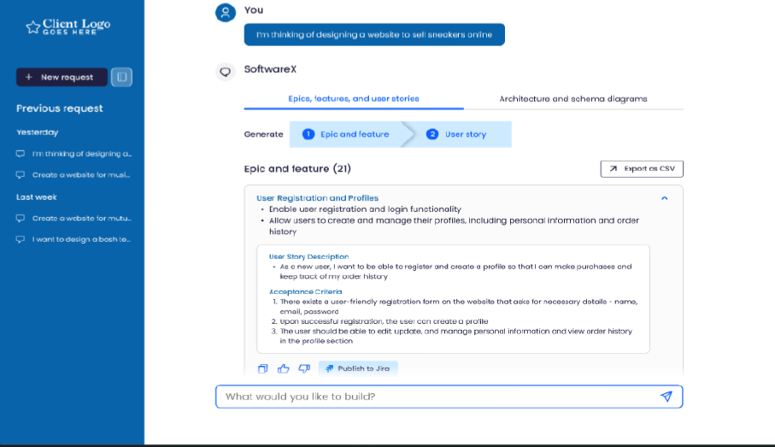
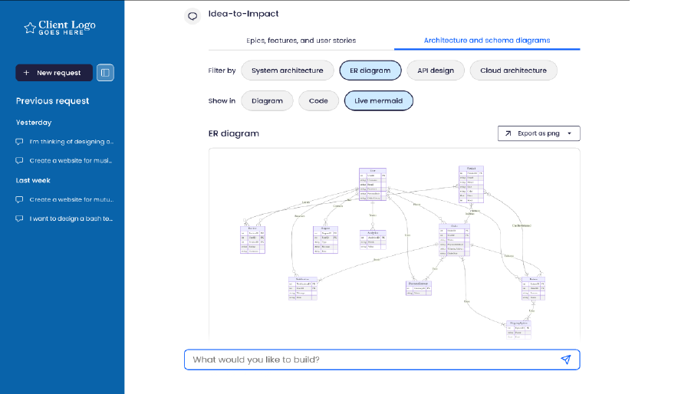
Refinement: Modern GenAI tools drastically accelerate everything from the definition of requirements and stories to arch. diagrams
To replace with AI Force if possible
Example 1: Idea to Requirement creates epics, features & user stories with acceptance criteria
Example 2: Requirement to Diagram creates architecture diagrams based on user stories
Saves DPOs, SEs, TLs, and SW Engineers a significant amount of time when creating robust and dev ready sprint backlogs while also standardizing story format which creates consistency for developers across the Policy Mod program
Produces diagrams and design decision records (e.g., in LucidChart, Miro) based on user stories and parameters, serving as a starting point for engineers to build a project’s architecture and data schema

Slide 17

Testing: Use cases with GenAI are expanding beyond unit test generation to span the entire test workflow
Example experience from a large tech client
What we saw in the DevX Lab
(June 2023)
What we saw in practice
(December 2023)
Without generative AI
With generative AI
Unit test generation
(primary focus for specialty test vendors like diffblue)
Generate comprehensive set of unit tests for existing code (via Copilot, diffblue, etc.)
Review and enhance existing unit tests
Task completion time, %
100
Intelligent data generation
Generate realistic data required for test scenarios (e.g., user information such as names, ages, locations, etc.)
Modify existing test datasets (e.g., extend all date ranges to cover last 50 years)
90
80
45-50
70
60
50
Test workflow script generation
Generate scripts for test workflows (e.g., automated test triggers every 4 hours)
Potential to enhance with fine tuning on standard workflow designs
Summarize and analyze automated test results
40
30
20
10
0
Complex SQL query writing and explanation
Explain and modify complex SQL queries
Write new SQL queries
Unit test generation
Source: McKinsey DevX Labs, June 2023

Slide 18

Testing: Based on initial interviews, Policy Mod has 3 key opportunities in testing
Test category
Opportunity
Impact, % time savings
Initial experiments validate our time savings hypotheses
Unit testing
Test generation: automate creation and execution of unit tests with Copilot, reducing manual effort and increasing coverage / code quality
35-45%
FS Client teams ran two small-scale experiments with unit test generation (not formalized; pilots required to confirm)
Life Co. (GitLab) Time writing unit test cases, minutes
Functional testing
Test case and scenario creation: generate functional test cases, diverse scenarios, and scripts with AI Force or similar tools
20-40%
-58%
FROM
TO
Enterprise Mobile (Copilot Visual Studio) Time writing unit test cases, minutes
Integration testing
Test data generation: create realistic test data for complex integrations and scenarios (AI Force applicability to be verified)
20-30%
-75%
FROM
TO

Slide 19
Agenda for today
Current processes and pain points
GenAI / productivity opportunities at FS Client Policy Modernization (Dwelling)
Path forward

Slide 20




Next Steps
Prioritize set of GenAI interventions and initiatives
Finalize deep dive sessions with SMEs to refine proposed interventions
Detail pilot implementation and tracking plans
Outline requirements and roadmap for tooling

Slide 21
Sample pilot implementation roadmap
8 weeks
12-16 weeks
6-12 months
MVP Development
Frontrunners
Scale up
1
2
3
Value to be captured
Improved productivity, quality, and dev experience across impacted product teams
Typically see a measurable 20-30% lift in productivity in- year that can be re- invested in other products and initiatives
Activities
Align on baseline productivity through DVI survey and baseline data received
Size impact potential on productivity
Identify candidate list for frontrunners and align on shape of the broader program (timing for front-runners, targeted impact, commercial model)
Launch candidate frontrunner product teams based on pilot insights
Select and prioritize interventions (from a set of levers including GenAl tools) based on pilot insights + unique characteristics of each frontrunner
Turn individual coaching into structured learning sessions
Continuously measure and monitor impact on productivity
Launch Engineering Academy in waves to train developers across the organization
Continuously measure and monitor productivity impact
Take actions to capture value (e.g., re-invest in new products/initiatives)
Outcome
Productivity levers identified (including GenAl tools), tested and validated through the pilot
Alignment on front-runner candidates and broader program
Initiatives executed according to published timelines
Measurable impact delivered in each product team
Tailored structured learning developed for scale-up
Cohorts of engineers received structured training on prioritized interventions
Measurable productivity impact across developer organization

